Slide 1
CHAPTER 20:
Total Quality Management
to accompany
Introduction to Business Statistics
seventh edition, by Ronald M. Weiers
Presentation by Priscilla Chaffe-Stengel
Donald N. Stengel
© 2011 Cengage Learning.
All Rights Reserved. May not be scanned, copied, or duplicated, or posted to a publicly accessible website, in whole or in part.

Slide 2
Chapter 20 - Learning Objectives
Understand the philosophy of total quality management (TQM).
Be able to distinguish between defect prevention and defect detection strategies for the management of quality.
Be able to distinguish random variation from assignable variation.
Understand the fundamentals of statistical process control charts.
Be able to prepare and interpret the major types of control charts.
Determine and interpret the value of the process capability index.
© 2011 Cengage Learning.
All Rights Reserved. May not be scanned, copied, or duplicated, or posted to a publicly accessible website, in whole or in part.

Slide 3
Total Quality Management
A management philosophy that integrates quality into all facets of an organization and focuses on systematic improvement
Process orientation rather than results orientation
Emphasis on small continuous improvements rather than relying on large-scale innovations
© 2011 Cengage Learning.
All Rights Reserved. May not be scanned, copied, or duplicated, or posted to a publicly accessible website, in whole or in part.

Slide 4
TQM-Related Practices
The Six Sigma Approach
The Quality Audit
Competitive Benchmarking
Just-In-Time Manufacturing
Quality Circles
Baldrige National Quality Award
© 2011 Cengage Learning.
All Rights Reserved. May not be scanned, copied, or duplicated, or posted to a publicly accessible website, in whole or in part.

Slide 5
The Process Flow Chart
A process flow chart diagrams the sequence of subprocesses of a larger process.
The sequential outline of subprocesses facilitates discussion and data collection at key points.
© 2011 Cengage Learning.
All Rights Reserved. May not be scanned, copied, or duplicated, or posted to a publicly accessible website, in whole or in part.

Slide 6
The Cause-and-Effect “Fishbone”
Nicknamed a “fishbone” diagram because of its typical shape, the cause-and-effect diagram details causes on the left that feed into the eventual effect on the right.
Causes usually detail people, methods, materials, machines, and the work environment.
© 2011 Cengage Learning.
All Rights Reserved. May not be scanned, copied, or duplicated, or posted to a publicly accessible website, in whole or in part.

Slide 7
The Pareto Diagram
A Pareto diagram is a bar chart illustrating the major types of defects in a product or service.
The size of each bar indicates the relative frequency of the associated type of defect.
Types of defects are sorted by decreasing relative frequency.
© 2011 Cengage Learning.
All Rights Reserved. May not be scanned, copied, or duplicated, or posted to a publicly accessible website, in whole or in part.

Slide 8
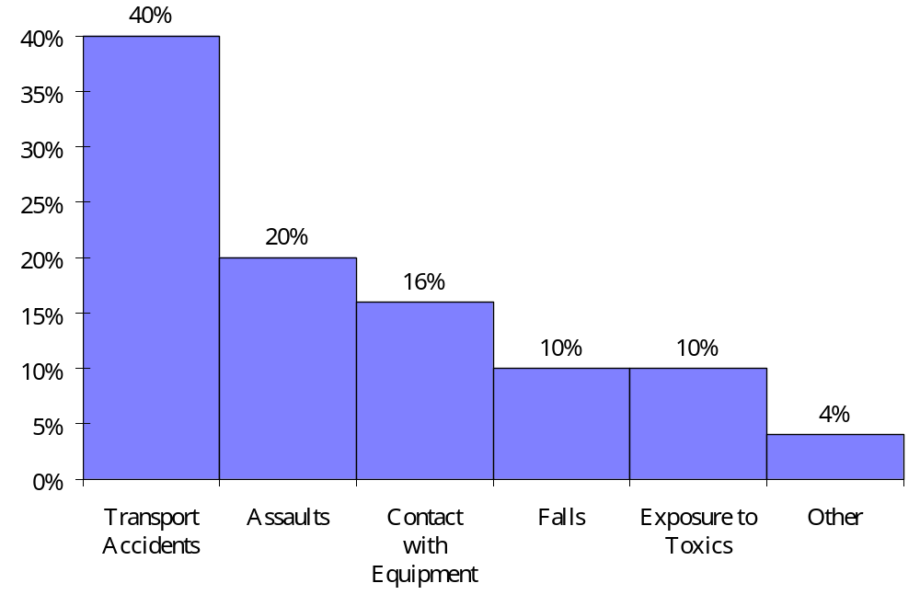
Pareto Diagram - An Example
Problem: Fatal Work Injuries
© 2011 Cengage Learning.
All Rights Reserved. May not be scanned, copied, or duplicated, or posted to a publicly accessible website, in whole or in part.

Slide 9
Quality and Process Variation
The quality of products and services is related to variation in the underlying processes.
Two sources of process variation:
  Random variation
  Assignable variation
© 2011 Cengage Learning.
All Rights Reserved. May not be scanned, copied, or duplicated, or posted to a publicly accessible website, in whole or in part.

Slide 10
Random Variation
... is variation due to chance that is inherent in the design of the process.
... can be reduced by using a better design, better materials, or better equipment.
© 2011 Cengage Learning.
All Rights Reserved. May not be scanned, copied, or duplicated, or posted to a publicly accessible website, in whole or in part.

Slide 11
Assignable Variation
Assignable variation is due to a specific, identifiable cause which, in turn, changes the process, such as worker error.
Statistical process control is a procedure for monitoring and analyzing process variation so that assignable variation can be identified and reduced.
© 2011 Cengage Learning.
All Rights Reserved. May not be scanned, copied, or duplicated, or posted to a publicly accessible website, in whole or in part.

Slide 12
Control Charts
Control charts are graphical tools for statistical process control.
Output from the process is sampled at regular intervals.
Measurements from successive samples are plotted on a control chart.
© 2011 Cengage Learning.
All Rights Reserved. May not be scanned, copied, or duplicated, or posted to a publicly accessible website, in whole or in part.

Slide 13
Use of Control Charts
When the process remains within control limits, process variation can be attributed to random variation and deemed “in control.”
When the process goes beyond control limits, it is likely that significant assignable variation is present. The process is then deemed “out of control.”
© 2011 Cengage Learning.
All Rights Reserved. May not be scanned, copied, or duplicated, or posted to a publicly accessible website, in whole or in part.

Slide 14
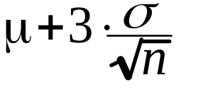
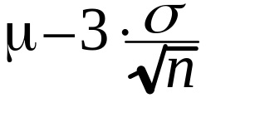
Mean Charts (µ, σ known)
Control chart showing sample means over successive samples.
If mean µ and standard deviation σ for the process are known:
  Centerline of control chart is defined by µ.
  Upper control limit is defined by ,
  where n is the size of each sample.
  Lower control limit is defined by .
© 2011 Cengage Learning.
All Rights Reserved. May not be scanned, copied, or duplicated, or posted to a publicly accessible website, in whole or in part.

Slide 15
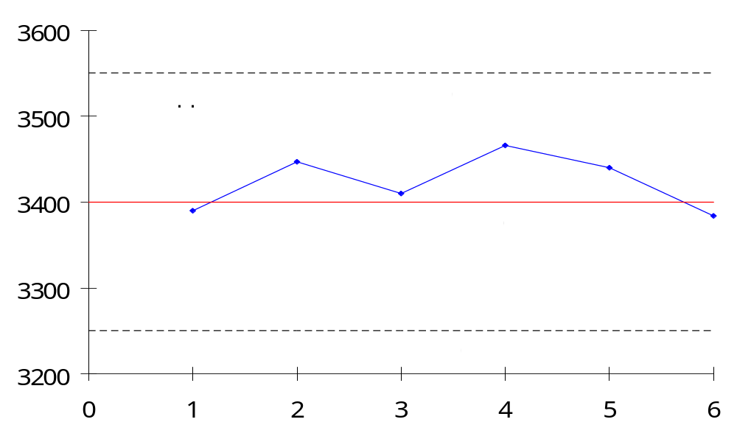
Mean Chart - Problem 20.39
Burst Strength of Gas Cylinder: µ = 3400 psi, σ = 100 psi, n = 4
Process is in control.
© 2011 Cengage Learning.
All Rights Reserved. May not be scanned, copied, or duplicated, or posted to a publicly accessible website, in whole or in part.

Slide 16
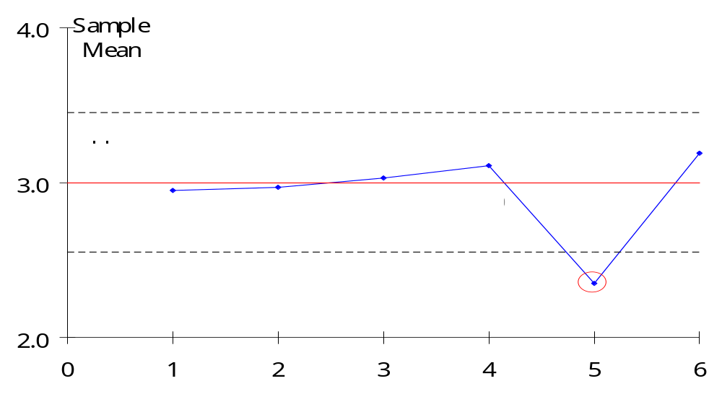
Mean Chart - Problem 20.41
Thickness of Coating: µ = 3.000 mil, σ = 0.300 mil, n = 4
Process is out of control. Sample 5 is outside the control limit.
© 2011 Cengage Learning.
All Rights Reserved. May not be scanned, copied, or duplicated, or posted to a publicly accessible website, in whole or in part.

Slide 17
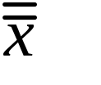
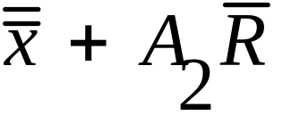

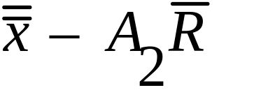
Mean Charts (µ, σ unknown)
The centerline is defined by , the average of the sample means.
The upper control limit is defined by
where is the average of the sample ranges and A₂ is a value from the 3-Sigma Control Chart Factors Table.
The lower control limit is defined by
© 2011 Cengage Learning.
All Rights Reserved. May not be scanned, copied, or duplicated, or posted to a publicly accessible website, in whole or in part.

Slide 18

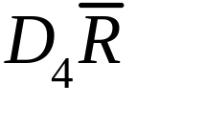
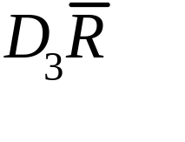
Range Charts
Range charts examine variation within samples by tracking sample ranges.
The centerline is defined by , the average of the sample ranges.
The upper control limit is defined by where D₄ is a value from the 3-Sigma Control Factors Table.
The lower control limit is defined by where D₃ is a value from the 3-Sigma Control Factors Table.
© 2011 Cengage Learning.
All Rights Reserved. May not be scanned, copied, or duplicated, or posted to a publicly accessible website, in whole or in part.

Slide 19
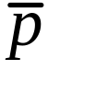
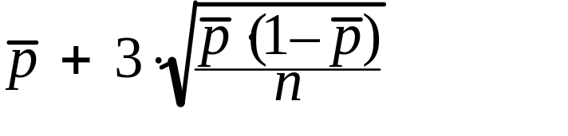
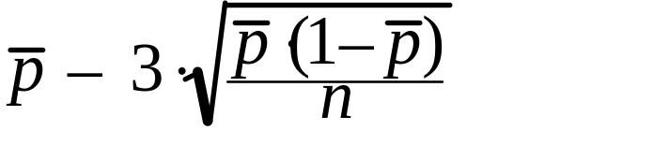
p-Charts
p-charts monitor the proportion of defective units across successive samples.
The centerline is defined by , the average of the sample proportions.
The upper control limit is defined by
where n is the sample size.
The lower control limit is defined by
© 2011 Cengage Learning.
All Rights Reserved. May not be scanned, copied, or duplicated, or posted to a publicly accessible website, in whole or in part.

Slide 20
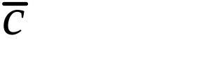
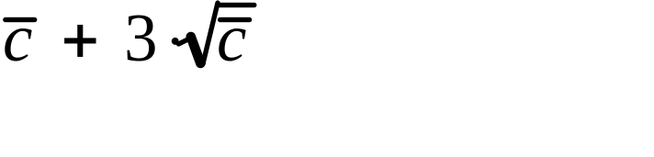
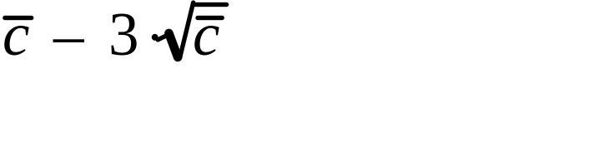
c-Charts
c-charts track the number of defects found in each samples.
The centerline is defined by , the average number of defects for the samples.
The upper control limit is defined by
The lower control limit is defined by
© 2011 Cengage Learning.
All Rights Reserved. May not be scanned, copied, or duplicated, or posted to a publicly accessible website, in whole or in part.

Slide 21
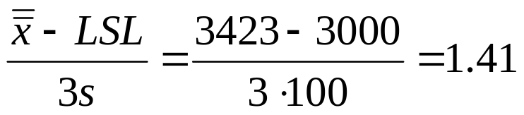
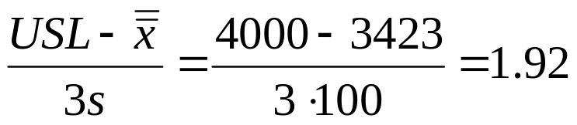
Process Capability Index for Problem 20.39
Suppose the LSL and USL for burst strength are 3000 and 4000 psi, respectively.
Process Capability Index C_{pk} is the lower of:
C_{pk} is 1.41, which is satisfactory capability, but does not satisfy requirements for a Six-Sigma process.
© 2011 Cengage Learning.
All Rights Reserved. May not be scanned, copied, or duplicated, or posted to a publicly accessible website, in whole or in part.

